Slide 1
Program 2
Recursion

Slide 2
The goal of this assignment is to give you lots of practice with recursion and identifying the complexity.
There are twelve independent problems.
If you need to get help with a few, you will still have lots of others to practice on your own.

Slide 3
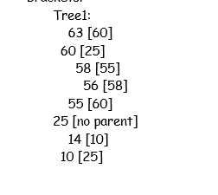
1. toString: shows tree in indented form. A parent pointer is present in the node, but this isn’t always the case.
25
10
60
14
55
63
58
56
This happens to be a BST – but not all trees in the assignment are binary search trees.

Slide 4
2. Write the function flip() to swap left and right children recursively
25
25
10
60
60
10
14
55
63
63
55
14
58
58
56
56

Slide 5
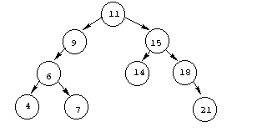
3. Write a function to find the inorder successor() [Next bigger] of a node (given the last node accessed in the BST tree). Look for different cases. This is to be efficient, given a specific node. Traversing the whole tree and finding the successor is not “efficient” for this operation. Parent pointers are helpful here.

Slide 6
4.Write the function nodesInLevel(level) that returns the total number of nodes on the specified level. For this problem, the root is at level zero, the root's children are at level one, and, for any node, the node's level is one more than its parent's level. Level 2: 3 (6,14,18)

Slide 7
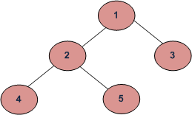
5. Given a binary tree, print out all of its root-to-leaf paths one per line. For the tree below, printAllPaths() would generate the following output:
1 2 4
1 2 5
1 3

Slide 8
6.Given a Binary Tree, the task is to print the nodes byLevelZigZag(int level) up to level. Nodes on even levels are printed right to left. Nodes on odd levels are printed right to left. There is no perfect way to do this. Think “outside the box”.
Input:
1
/ \
2 3
/ \ \
4 5 6
Output byLevelZigZag(2)= : 6 5 4 2 3 1
Output byLevelZigZag(1) = 2 3 1

Slide 9
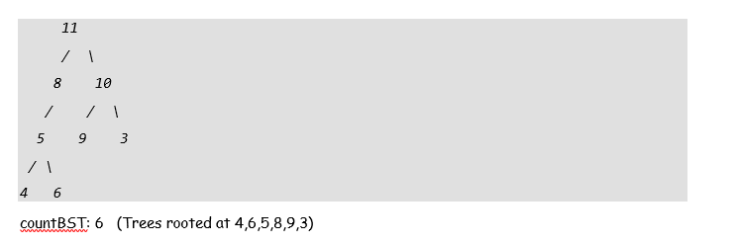
7. countBST() counts the number of Binary Search Trees present in a Binary Tree
It this case, the parent does inform the child the range it must be in. The communication goes the
other way.

Slide 10
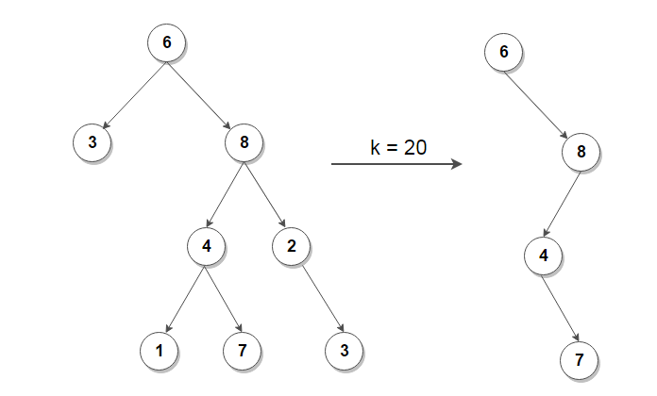
8. Given a number k, pruneK(int k) removes nodes from the tree which are not part of a path having sum greater than or equal to k. For example. What would you do if k=20?

Slide 11
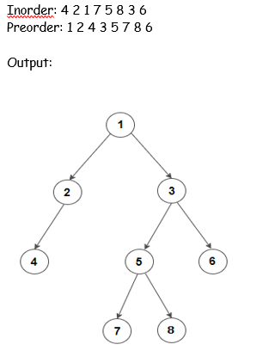
9. Create a tree from its inorder and preorder listing. The tree is not necessarily a BST. You may assume all elements are unique. Be sure to store parent references. You notice that having parent pointers may be helpful for some of the exercises, but it comes with the cost of having to always keep them current.

Slide 12
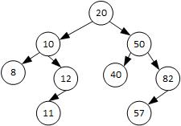
10. Write a function lca( int a, int b) which returns the least common ancestor of two nodes in a binary search tree. A least common ancestor is an ancestor of both nodes and is closest to the nodes. A node is considered to be an ancestor of itself. In the tree below, the least common ancestor of 82 and 8 is 20. The least common ancestor of 42 and 50 is 50 (even though 42 doesn’t exist). The least common ancestor of 57 and 40 is 50
This is made easy because of the fact that it is a BST. Look for an elegant solution.

Slide 13
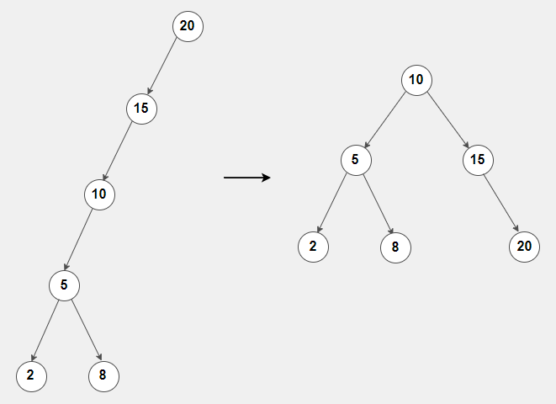
11. balanceTree() constructs a height balanced BST from an unbalanced BST. Notice we are not balancing via rotations, but just starting over. For example:

Slide 14
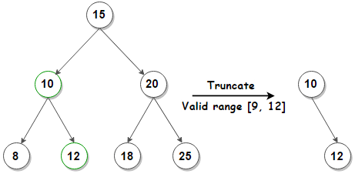
12. keepRange(E first, E last) removes nodes from a BST which have keys outside a valid range.

